Slide 1
DIGITAL PORTFOLIO
Student Name : S.Nivetha
Register No and NM id: C517021768C968CA0AD4CBACA98420F4.
Department : BSC Computer Science
College/University : Vidhya Sagar Womens College, Chengalpet/University of madras.

Slide 2
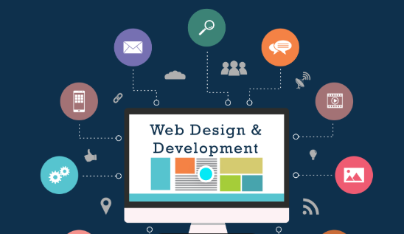
Project title : Digital Portfolio
Sub title: Frontend Developer
" A passionate Frontend Web Developer with a strong interest in creating clean, responsive, and user-friendly web applications. I enjoy turning ideas into interactive designs using HTML, CSS, and JavaScript, and I am continuously exploring frameworks like React to enhance my development skills. Alongside my college studies, I have completed HDCA, which strengthened my programming and computer application knowledge. My goal is to build modern, mobile-friendly websites with smooth animations and optimized performance, while contributing to innovative projects that make a real impact."

Slide 3

Agenda
1.Problem Statement
2.Project Overview
3.End Users
4.Tools And Technologies
5.Portfolio Design And Layout
6.Features And Functionality
7.Results And Screenshots
8.Conclusion
9. Github Link

Slide 4
Problem statement
1. Developers need a place to show their skills and projects.
2. Many existing profiles are static and boring.
3. Goal: Create a simple, interactive, and responsive portfolio website to highlight skills, education, and contact info.

Slide 5
project overview
Purpose: Showcase personal skills, education, projects, and contact information in a single website.
Technology Used:HTML – Structure of the websiteCSS – Styling, animations, responsive designJavaScript – Menu toggle, scroll effects, animations
Features:Responsive design for desktop and mobileAnimated sections on scrollInteractive navigation menuContact form for direct communicationSkill bars and progress indicators
Sections Included:Home, About, Education, Skills, ContactFooter with social links and scroll-to-top button
Goal: Provide an engaging and professional online presence for the developer.
PROJECT OVERVIEW

Slide 6
End users
1. Potential Employers / Recruiters – To check your skills, projects, and experience.
2. Clients – Who want to hire a Frontend Developer for projects.
3. Fellow Developers / Peers – For inspiration or collaboration.
4. Students / Beginners – To see a live example of a responsive, interactive portfolio.
5. Anyone Interested in Your Work – General visitors who want to learn about you professionally.

Slide 7
Tools and technologies
HTML – For the structure and content of the website (sections like Home, About, Skills, Contact).
2. CSS – For styling, animations, hover effects, and responsive design.
3. JavaScript – For interactive elements like:Menu toggleScroll-based active link highlighting Section animations Sticky header
4. Boxicons – For adding icons in navigation, social links, and sections.
5. Code Editor (VS Code / Others) – For writing and managing code efficiently.
6. Web Browser – To test responsiveness and functionality of the portfolio.

Slide 8
Portfolio design and layout
Header – Logo & navigation menu (sticky).
Home – Intro text, buttons, social links, background.
3. About – Profile image & short description.
Education – Timeline of studies.
Skills – Coding & professional skills with progress bars.
Contact – Form for messages.
Footer – Social links & scroll-to-top.

Slide 9
Features and Functionality
1. Responsive Design – Works smoothly on desktop, tablet, and mobile.
2. Animated Sections – Elements appear with animation when scrolling down.
3. Interactive Navigation Menu – Toggle menu for mobile view and highlights active sections.
4. Skill Bars – Display coding and professional skills visually with progress bars.
5. Contact Form – Users can send messages directly through the website.
6. Social Media Links – Quick access to Facebook, Instagram, GitHub, LinkedIn.
7. Sticky Header & Scroll Effects – Navigation remains visible and sections animate while scrolling.
8. Visual & Interactive Design – Hover effects on buttons, images, and content blocks.

Slide 10
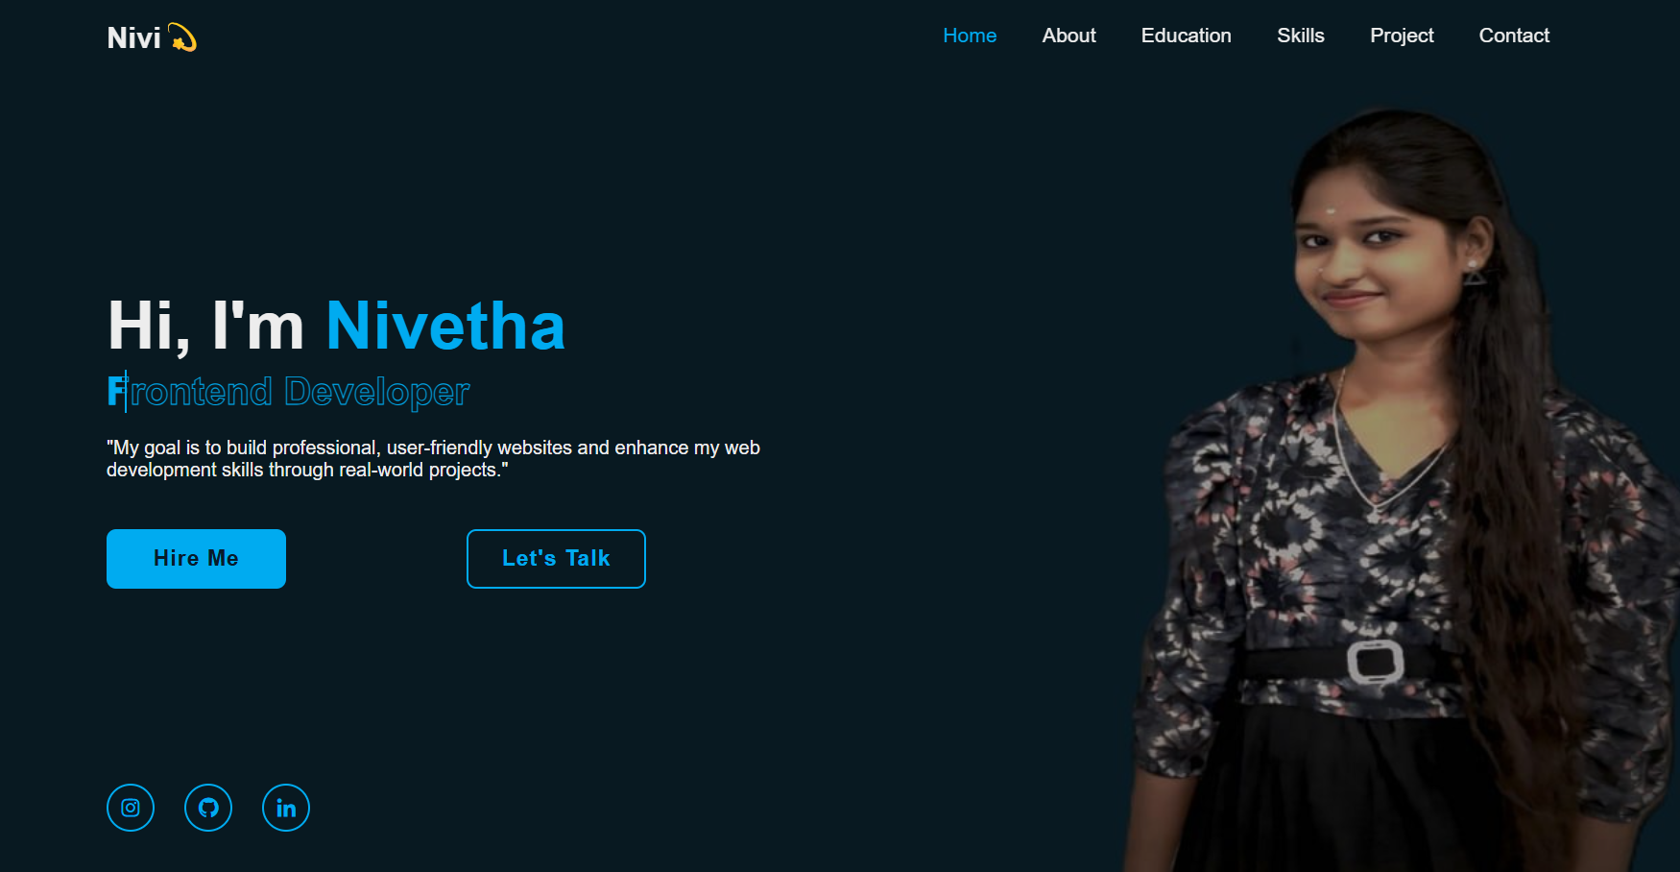
Result and screenshot
Fully Functional Website – All sections (Home, About, Education, Skills, Contact) work properly.
Responsive Design – Looks great on desktop, tablet, and mobile.
Interactive Features – Menu toggle, scroll animations, skill bars, and hover effects function smoothly.
Professional Online Presence – Clear display of skills, education, and contact info for potential employers/clients.

Slide 11
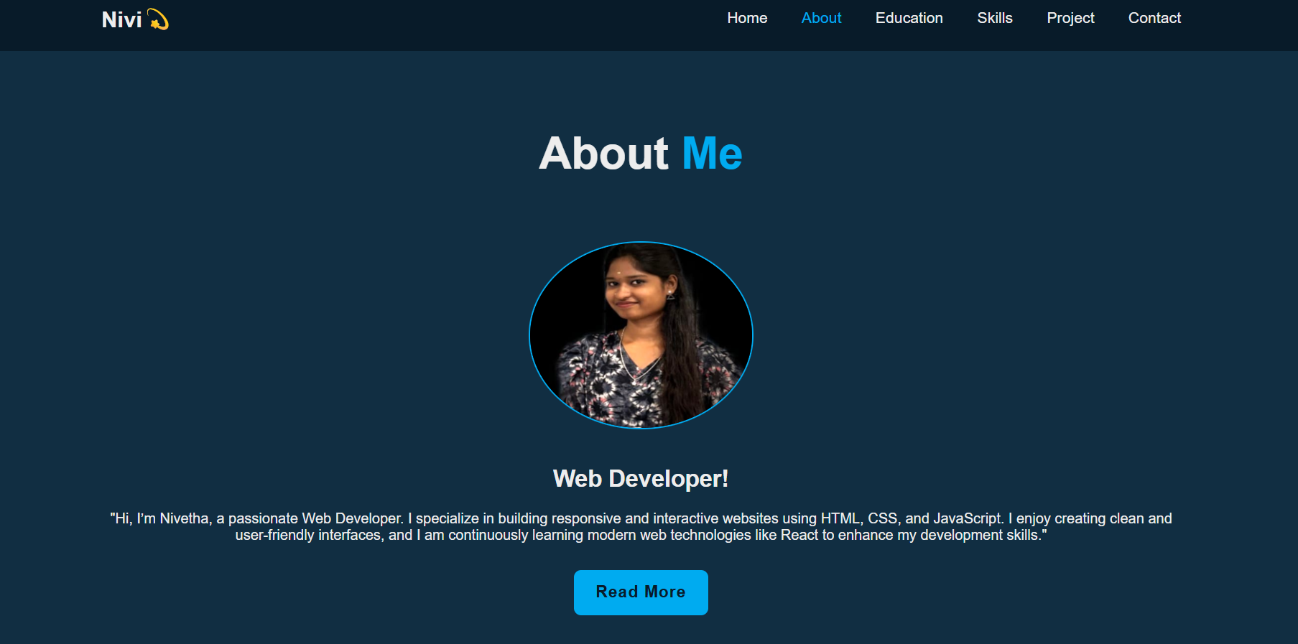
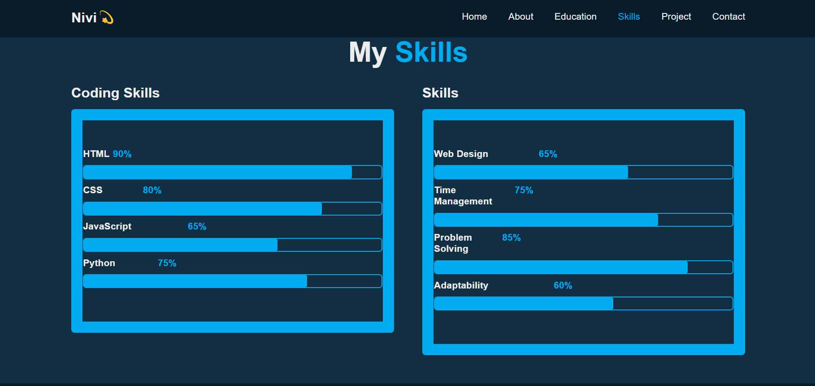

Slide 12
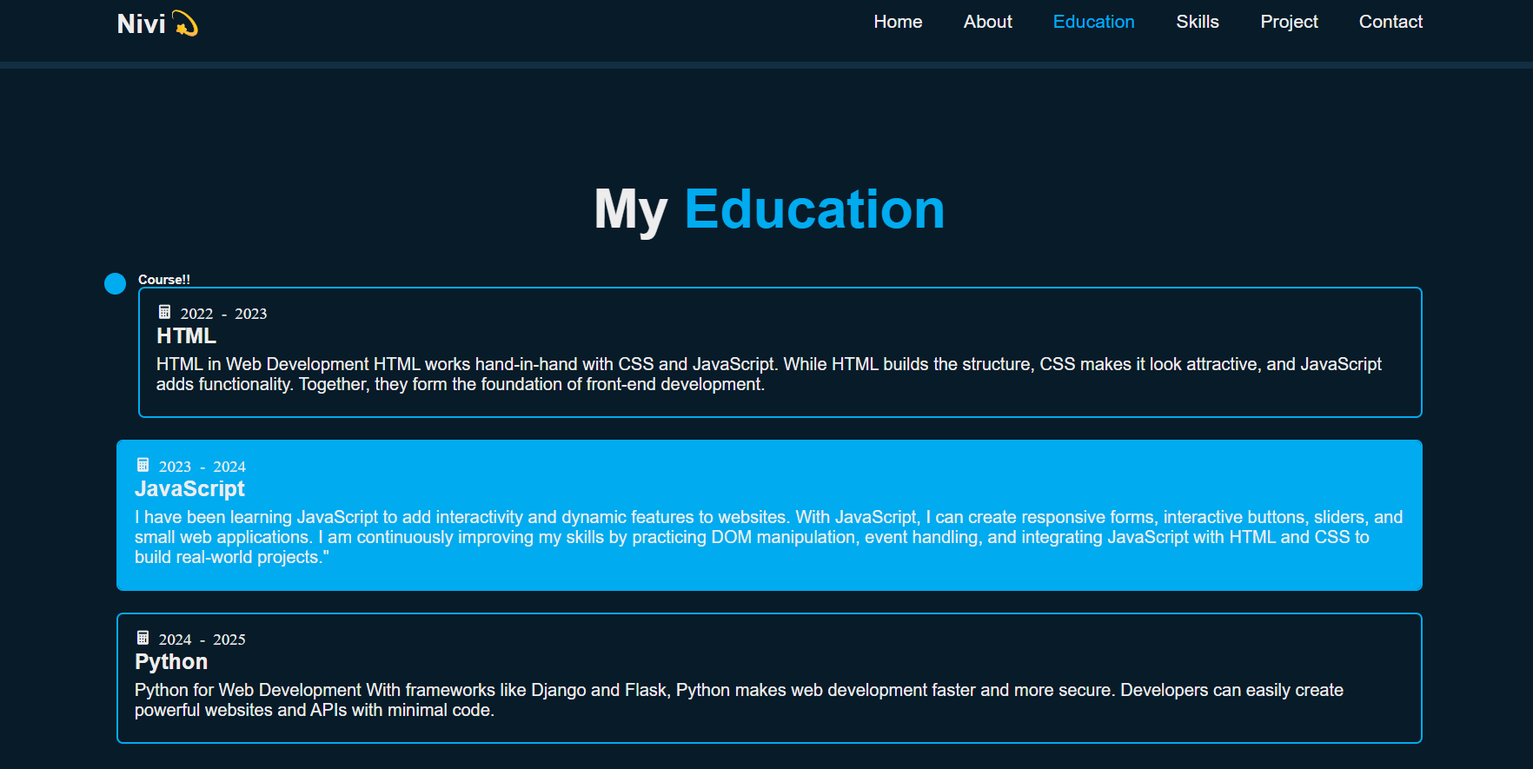

Slide 14
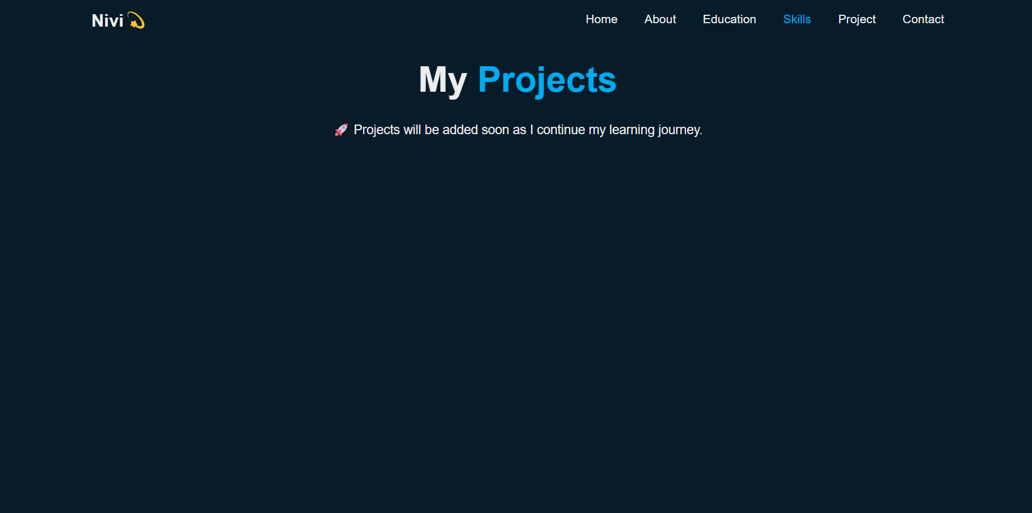

Slide 15
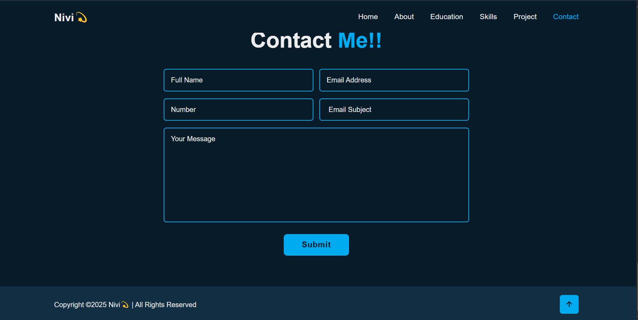

Slide 16
Conclusion
1. Successfully created a responsive and interactive digital portfolio using HTML, CSS, and JavaScript.
2. Website effectively showcases skills, education, and contact information.
3. Provides professional online presence for employers, clients, and peers.
4. Demonstrates practical implementation of animations, interactivity, and responsive design.
5. A foundation for future improvements like integrating frameworks (React), adding project sections, or advanced animations.

Slide 17
Thank you !!

